Slide 1
Lil’ Bitty Bishop Farm
By: Matthew Capps

Slide 2
Motivation
Wanted to develop a website for a local company
Expand my experience with real world programming and to build experience with working with an actual client
Build my portfolio and experience
Build a client base
Have a credible reference for the work i've done

Slide 3
Client’s Expectation
Easy to navigate webpage
Be able to add items to a cart and order them online and be able to track the order.
But the client changed their minds and didn't want this to be apart of the final design

Slide 4
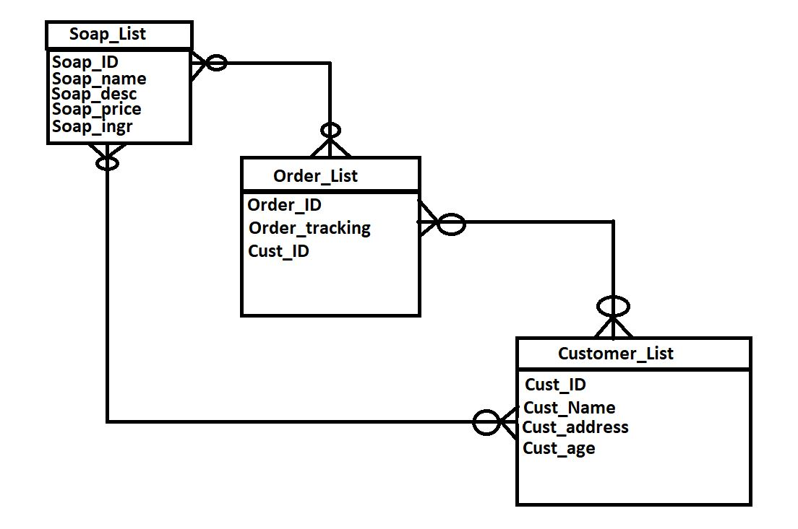
Database
Designed the ERD to at first have the customer be able to add items to a cart and order and be able to track their order.
But the client didn’t want this feature in the end because they wanted a more personal touch to the webpage.

Slide 5
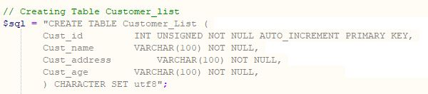
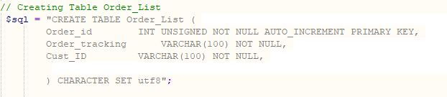
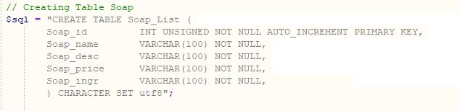
Database Tables
Code for creating the tables

Slide 6
Problems
Communication between client and myself was poor
Client continued to change their minds about the final design
Client sent the wrong data for their products after I finished creating the tables and populating them
Client continued to change their minds about the final design

Slide 7
Demo

